Slide 1

SNORT Real-Time Network Traffic Analysis Using Snort
By Yuvapriya S
2022503552

Slide 2
What is Snort?
Snort is a powerful open-source intrusion detection and prevention system (IDPS) used for real-time network traffic analysis.
It inspects network packets for suspicious activity and attacks, providing alerts and logs for security monitoring.

Slide 3
How Snort Analyzes Network Traffic
Snort captures packets using the PCAP library.
Analyzes headers, payloads, and protocols.
Signature-based detection: It uses predefined rules to match patterns of known attacks.
Flow tracking: Monitors connections and analyzes state transitions

Slide 4
Attack Vectors Detected by Snort
Port Scanning:
Detects multiple attempts to access various ports in a short time.
Common tool: Nmap
DDoS Attacks:
Identifies traffic floods, like SYN floods or UDP floods.
Unusual Protocol Usage:
Detects anomalies in the use of protocols (e.g., HTTP tunneling, DNS exfiltration).

Slide 5
Importance of Real-Time Monitoring
Early detection of security threats before they escalate.
Continuous monitoring provides immediate alerts on suspicious behavior.
Enables quick response to incidents, such as blocking malicious IP addresses.

Slide 6
Anomalous Protocol Detection with Snort
Unusual or unexpected protocol usage often signals suspicious behavior.
Examples:
HTTP Tunneling: Encapsulating other protocols in HTTP requests.
DNS Exfiltration: Using DNS queries to transfer data out of the network.
Impact: Spotting these anomalies helps prevent data exfiltration and evasion tactics.

Slide 7
PROBLEM STATEMENT
Use Snort to analyze real-time network traffic for anomalies and signs of suspicious behavior. Discuss how Snort’s packet inspection capabilities help identify common attack vectors, such as port scanning and unusual protocol usage, and the importance of real-time monitoring in network security.

Slide 8
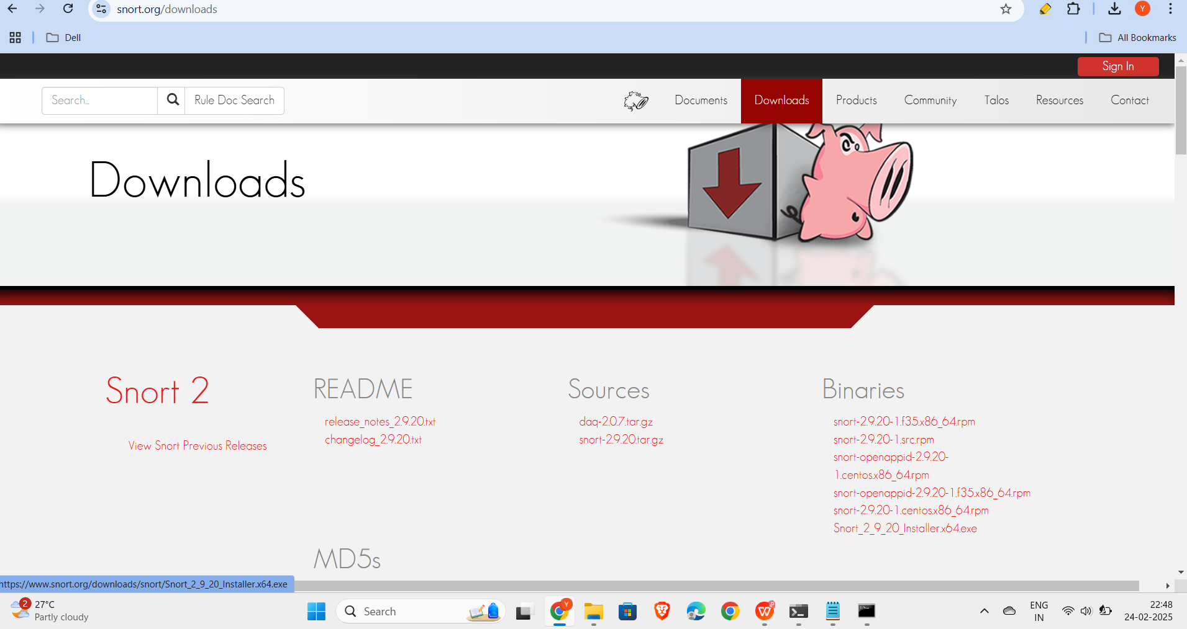
INSTALLATION

Slide 9
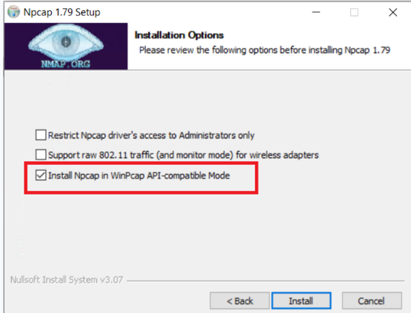
Step 2: Install npcap

Slide 10
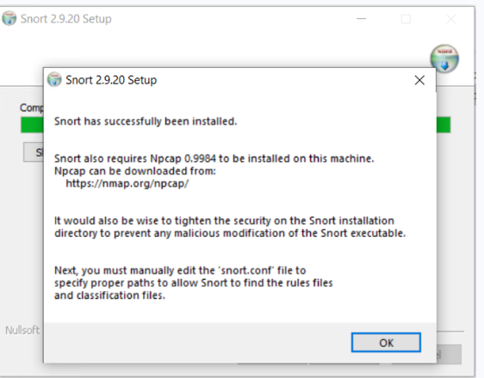
Step 3: install snort

Slide 11
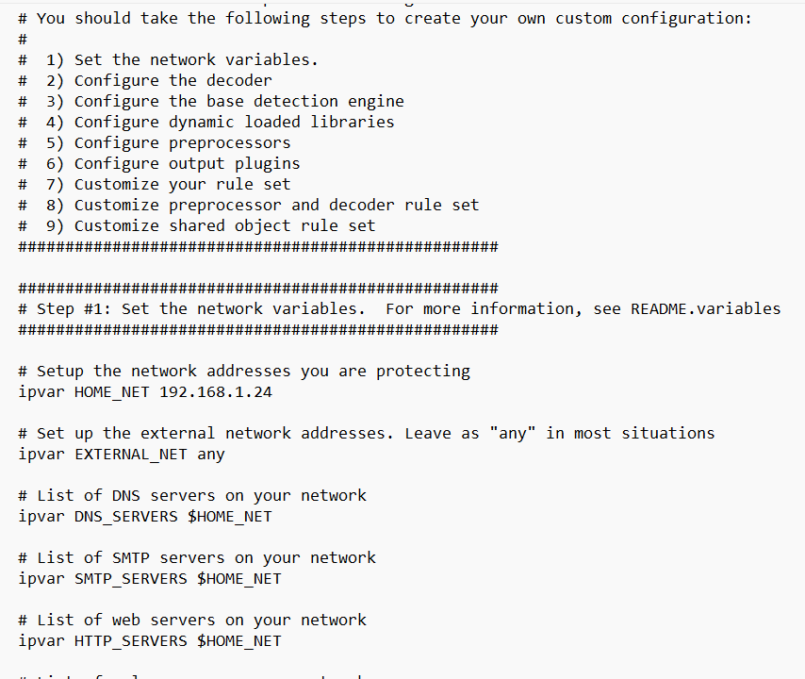
Step 4: go to snort.config and change ipaddress

Slide 12
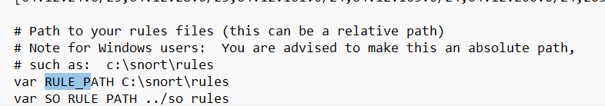
Step 5: add the rule path
Demo link:
https://drive.google.com/file/d/1OqSlYoVjh6DU3gjuem-aRau-Lf8XV-nt/view?usp=sharing

Slide 13
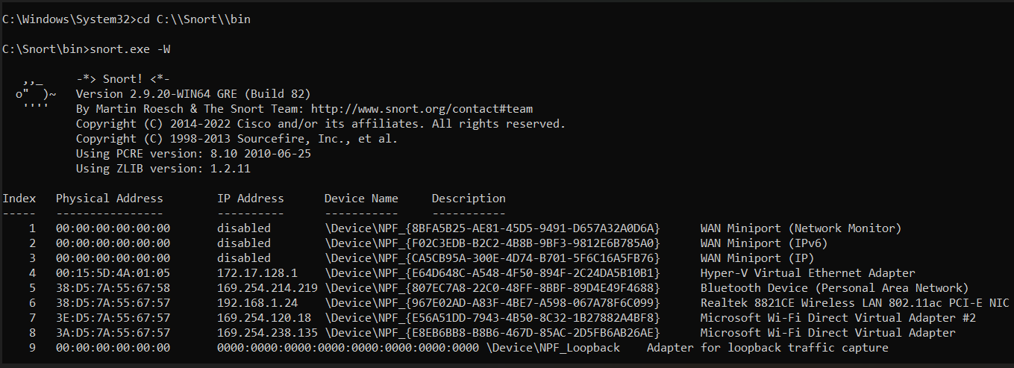
Step 6: Run snort and verify installation

Slide 14
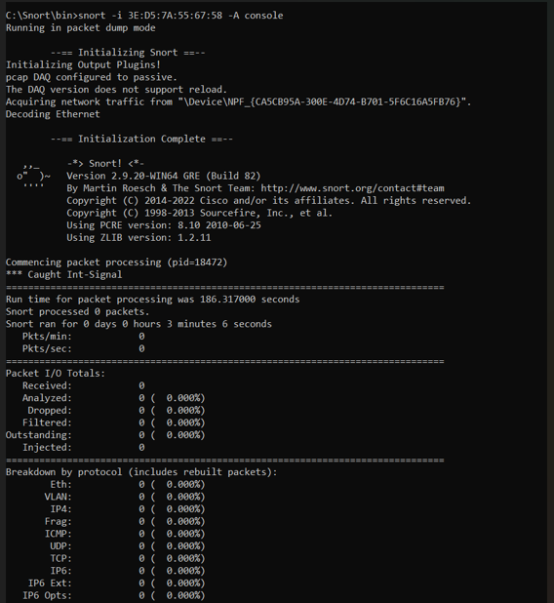
Step 7: wrong interface

Slide 15
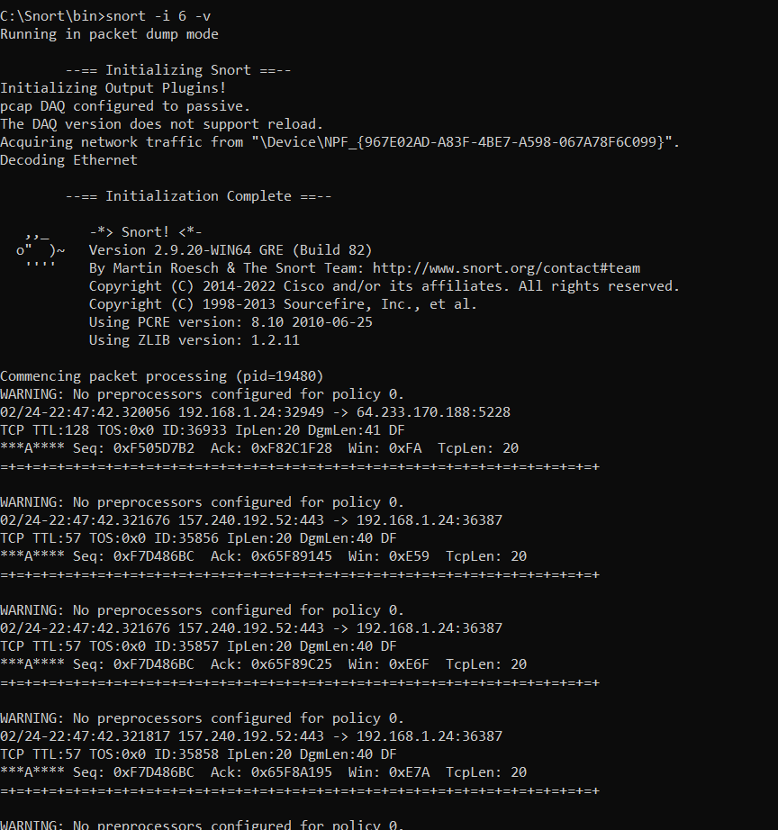
Giving correct interface

Slide 16
Thank you

